Slide 1
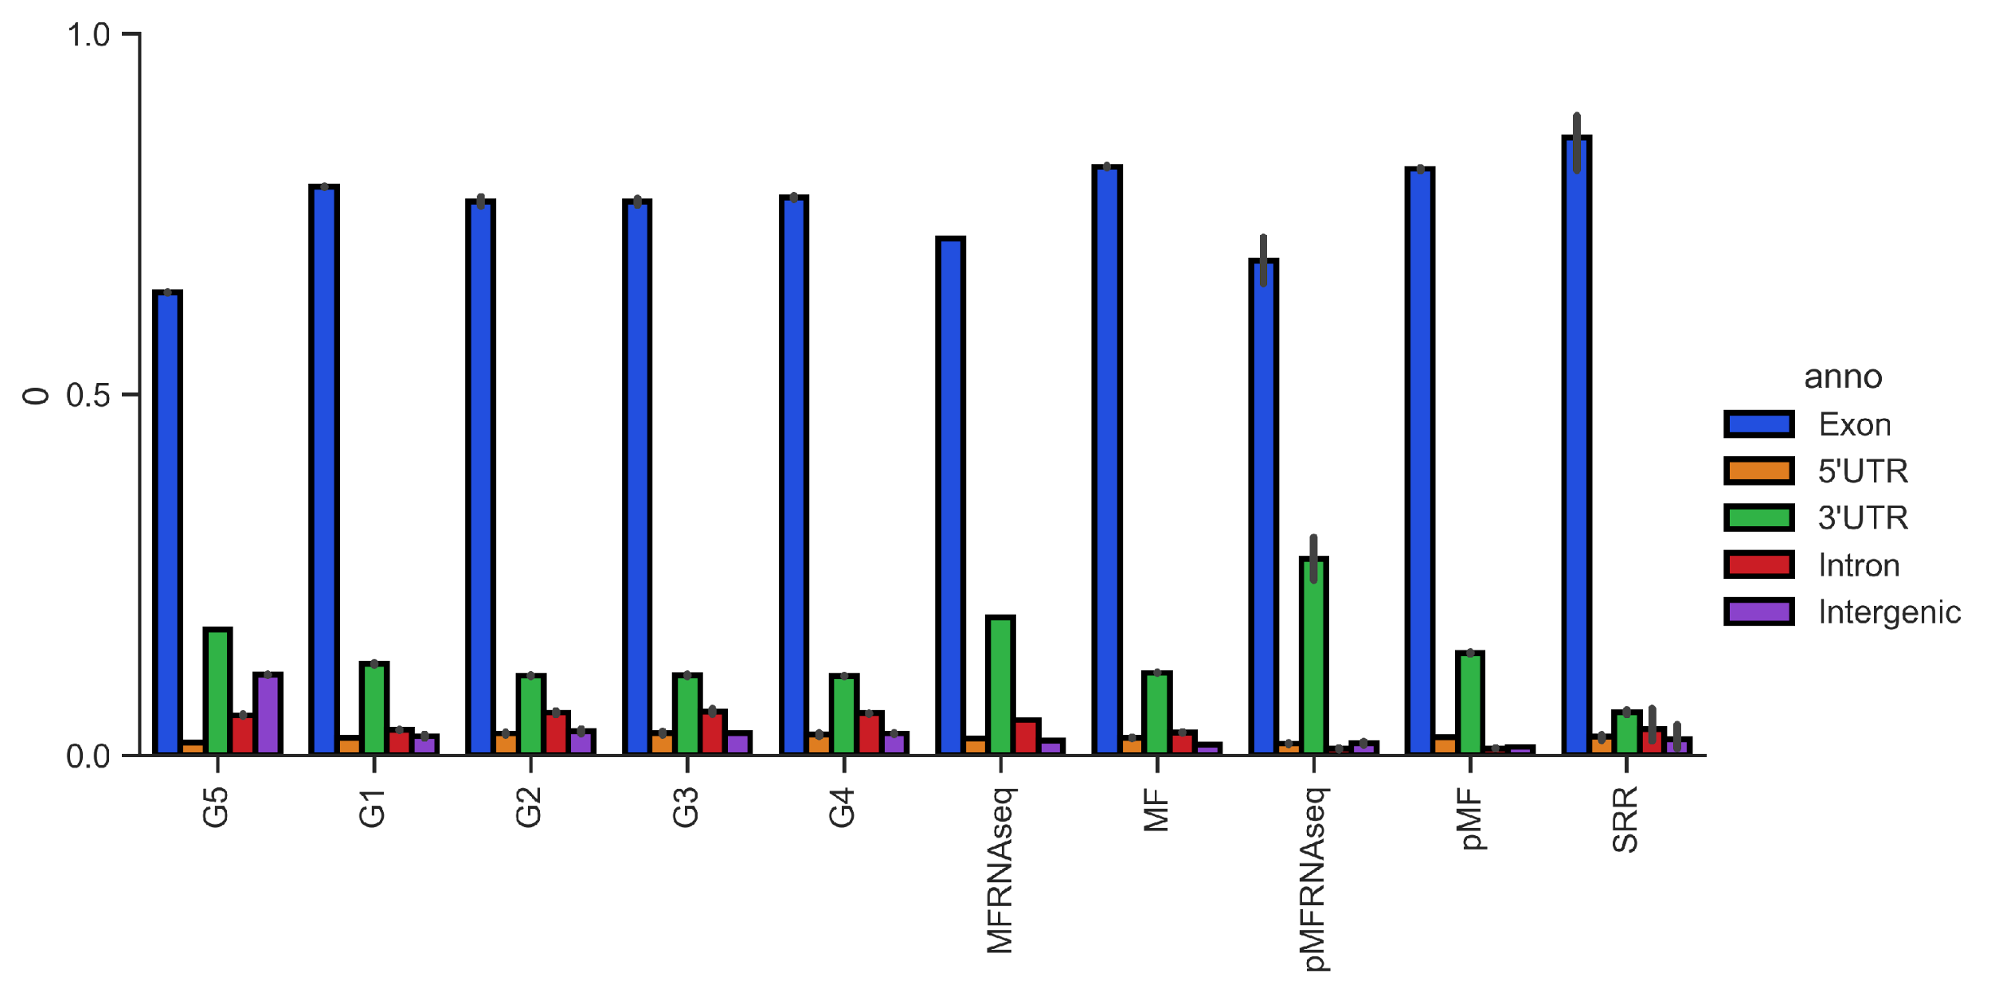
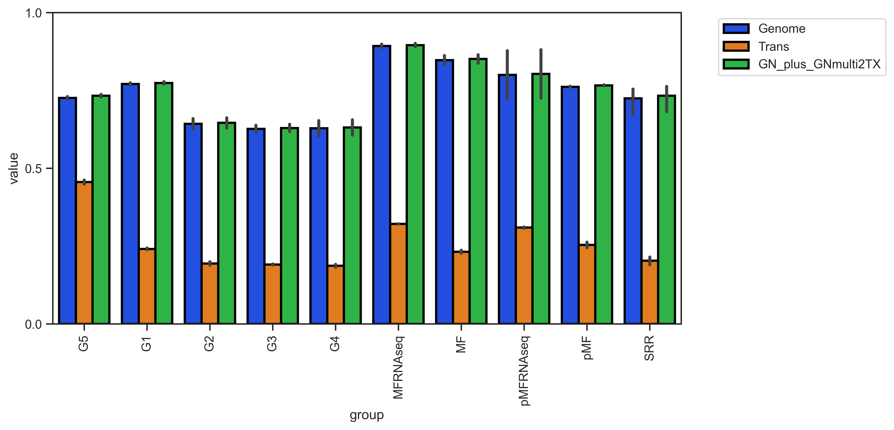
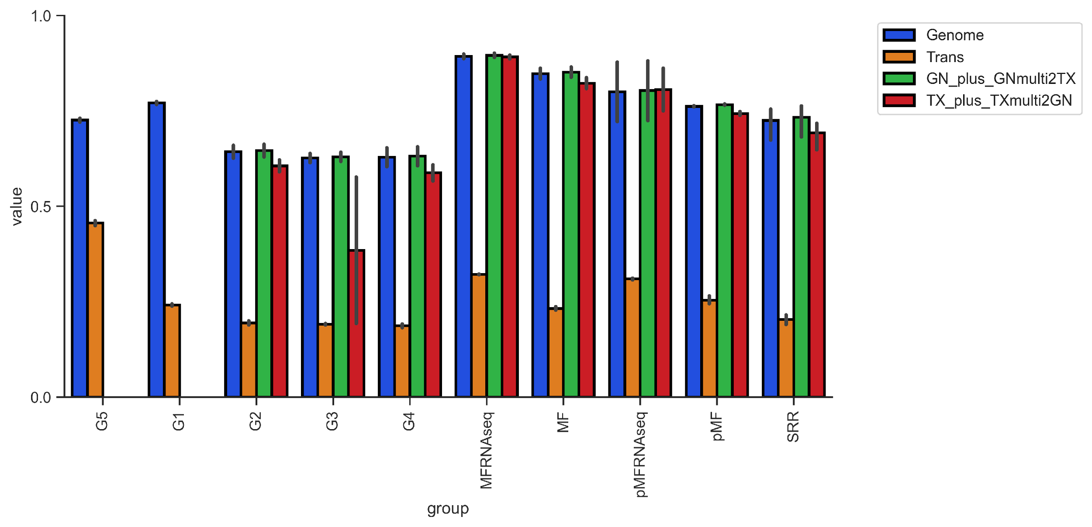
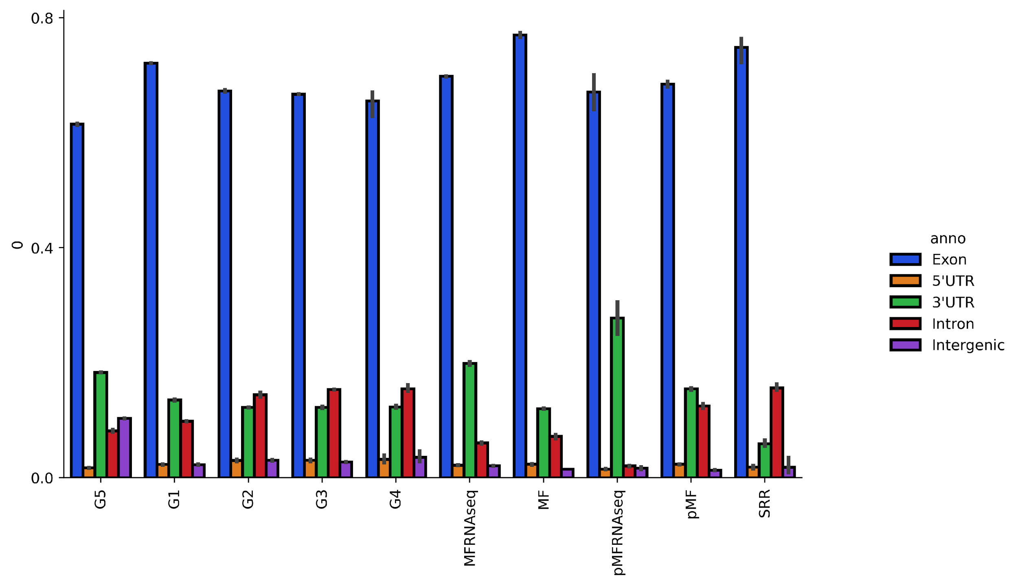
A
B
meRanGh
meRanT
meRanGh + meRanT
Annotation Distribution
Mapping Rate
MT-A
Huang
MT-A
Huang
MT-C
MT-C
MT RNAseq
MT-B
MT-D
MT RNAseq
MT-B
MT-D
Supplementary Figure 3. (A) Mapping rate of libraries using meRanGh (genome) and meRanT (transcriptome). Hybrid mapped reads were created by piping multi-mapped and unmapped reads to the unused mapping protocol (i.e., meRanGh multi-mapped and unmapped reads were used as input to meRanT to create aggregate Genome-mapped reads). Only uniquely mapped reads are reported. (B) Mapped transcripts were annotated using RSeQC [49] and RefSeq mm10 annotations.
Notes:
(A) Mapping rate of libraries using meRanGh (genome) and meRanT (transcriptome). Hybrid mapped reads were created by piping multi-mapped and unmapped reads to the unused mapping protocol (ie meRanGh multi-mapped and unmapped reads were used as input to meRanT to create aggregate Genome-mapped reads). Only uniquely mapped reads are reported. (B) Mapped transcripts were annotated using RSeQC [33] and RefSeq mm10 annotations.

